Slide 1
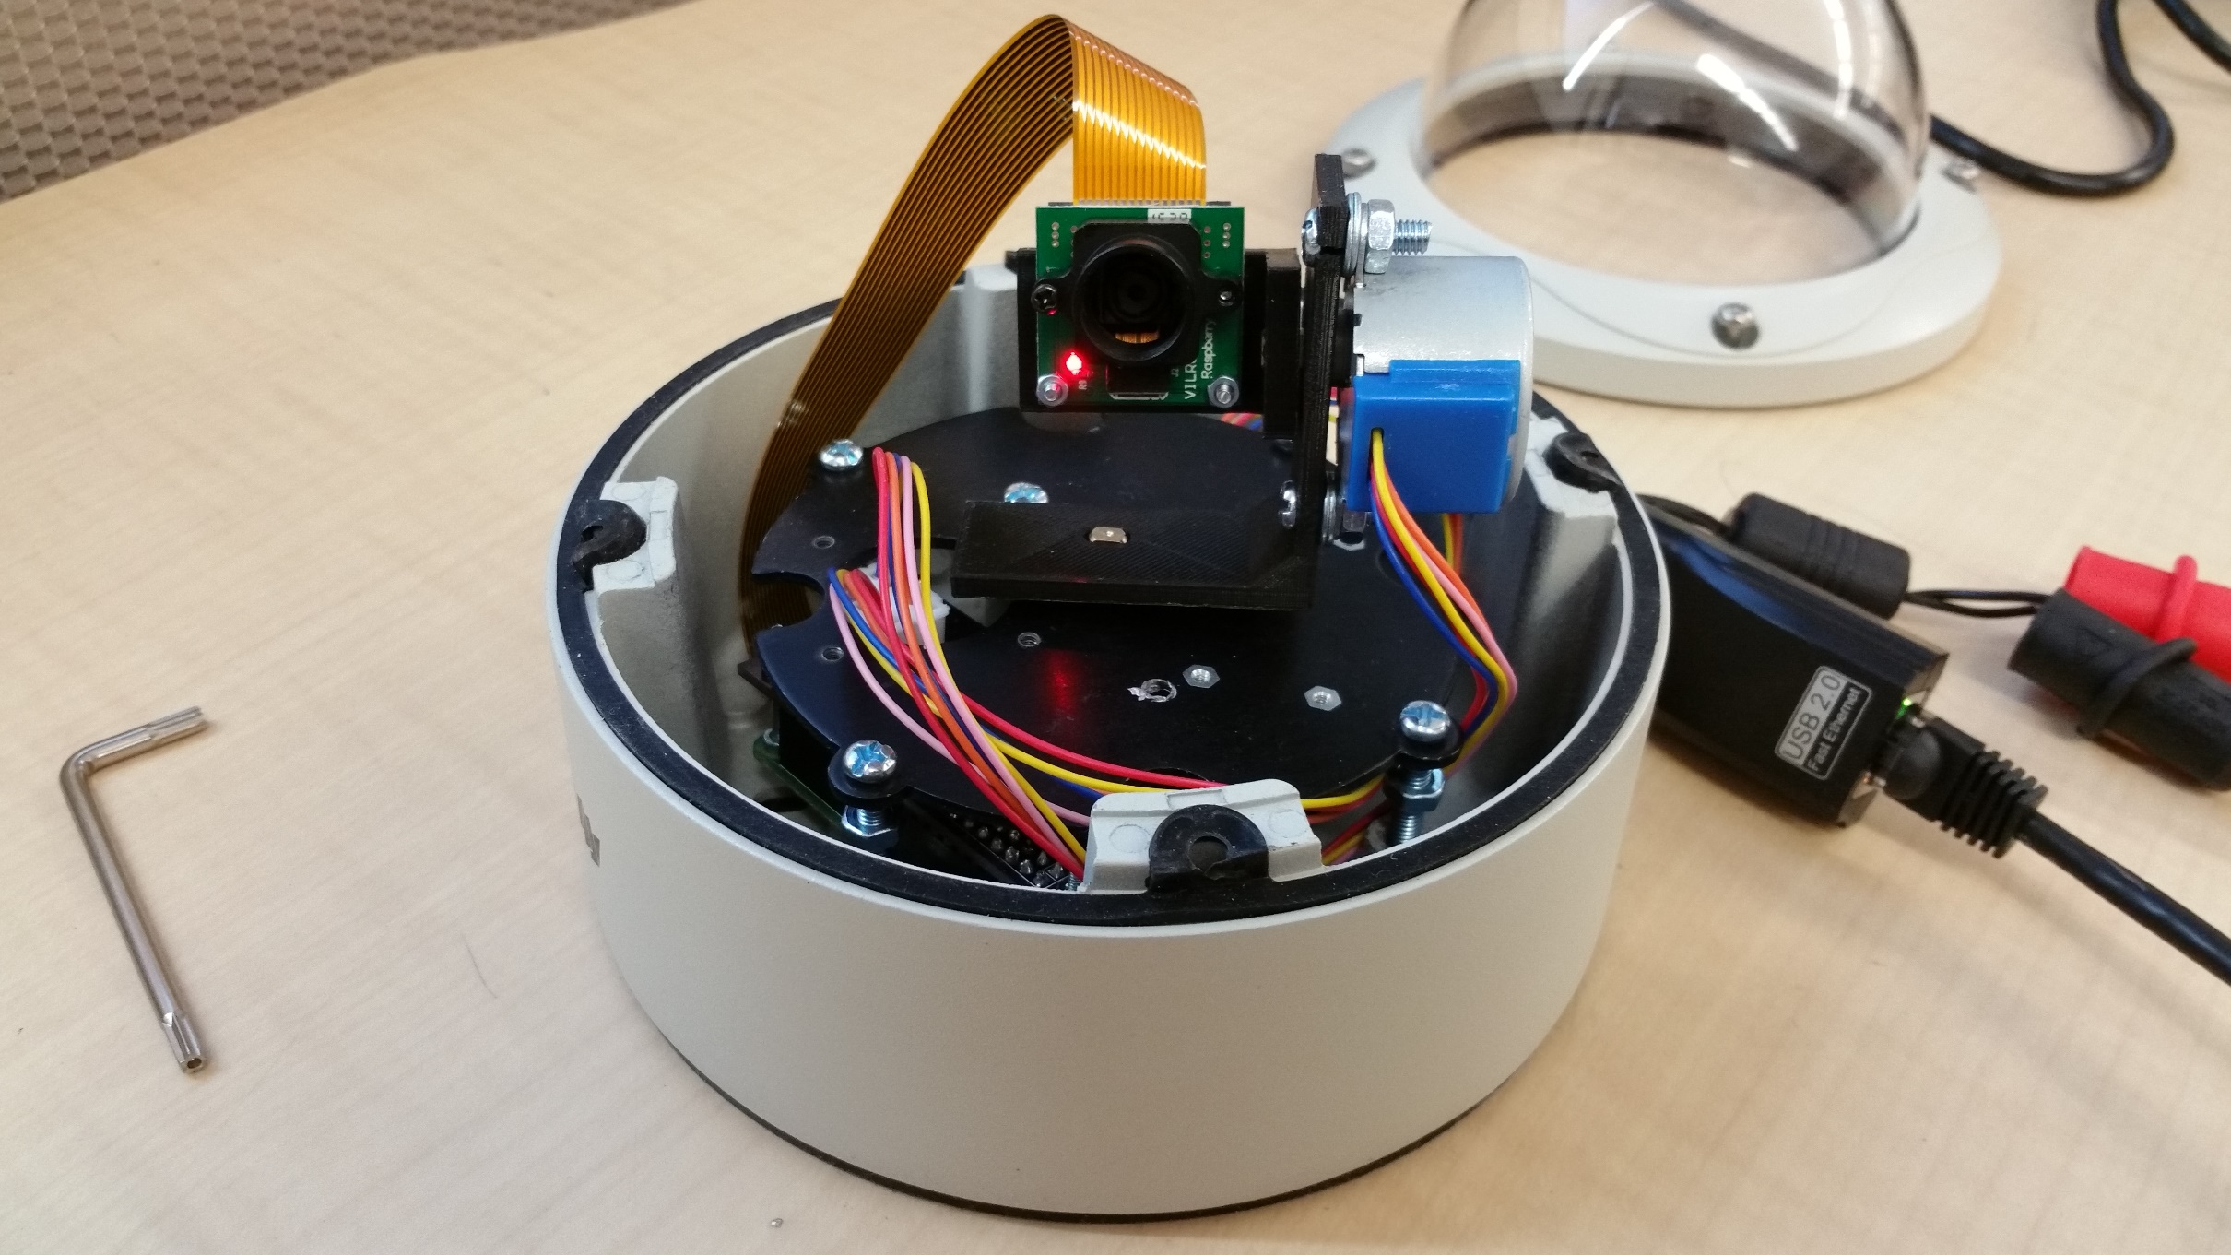
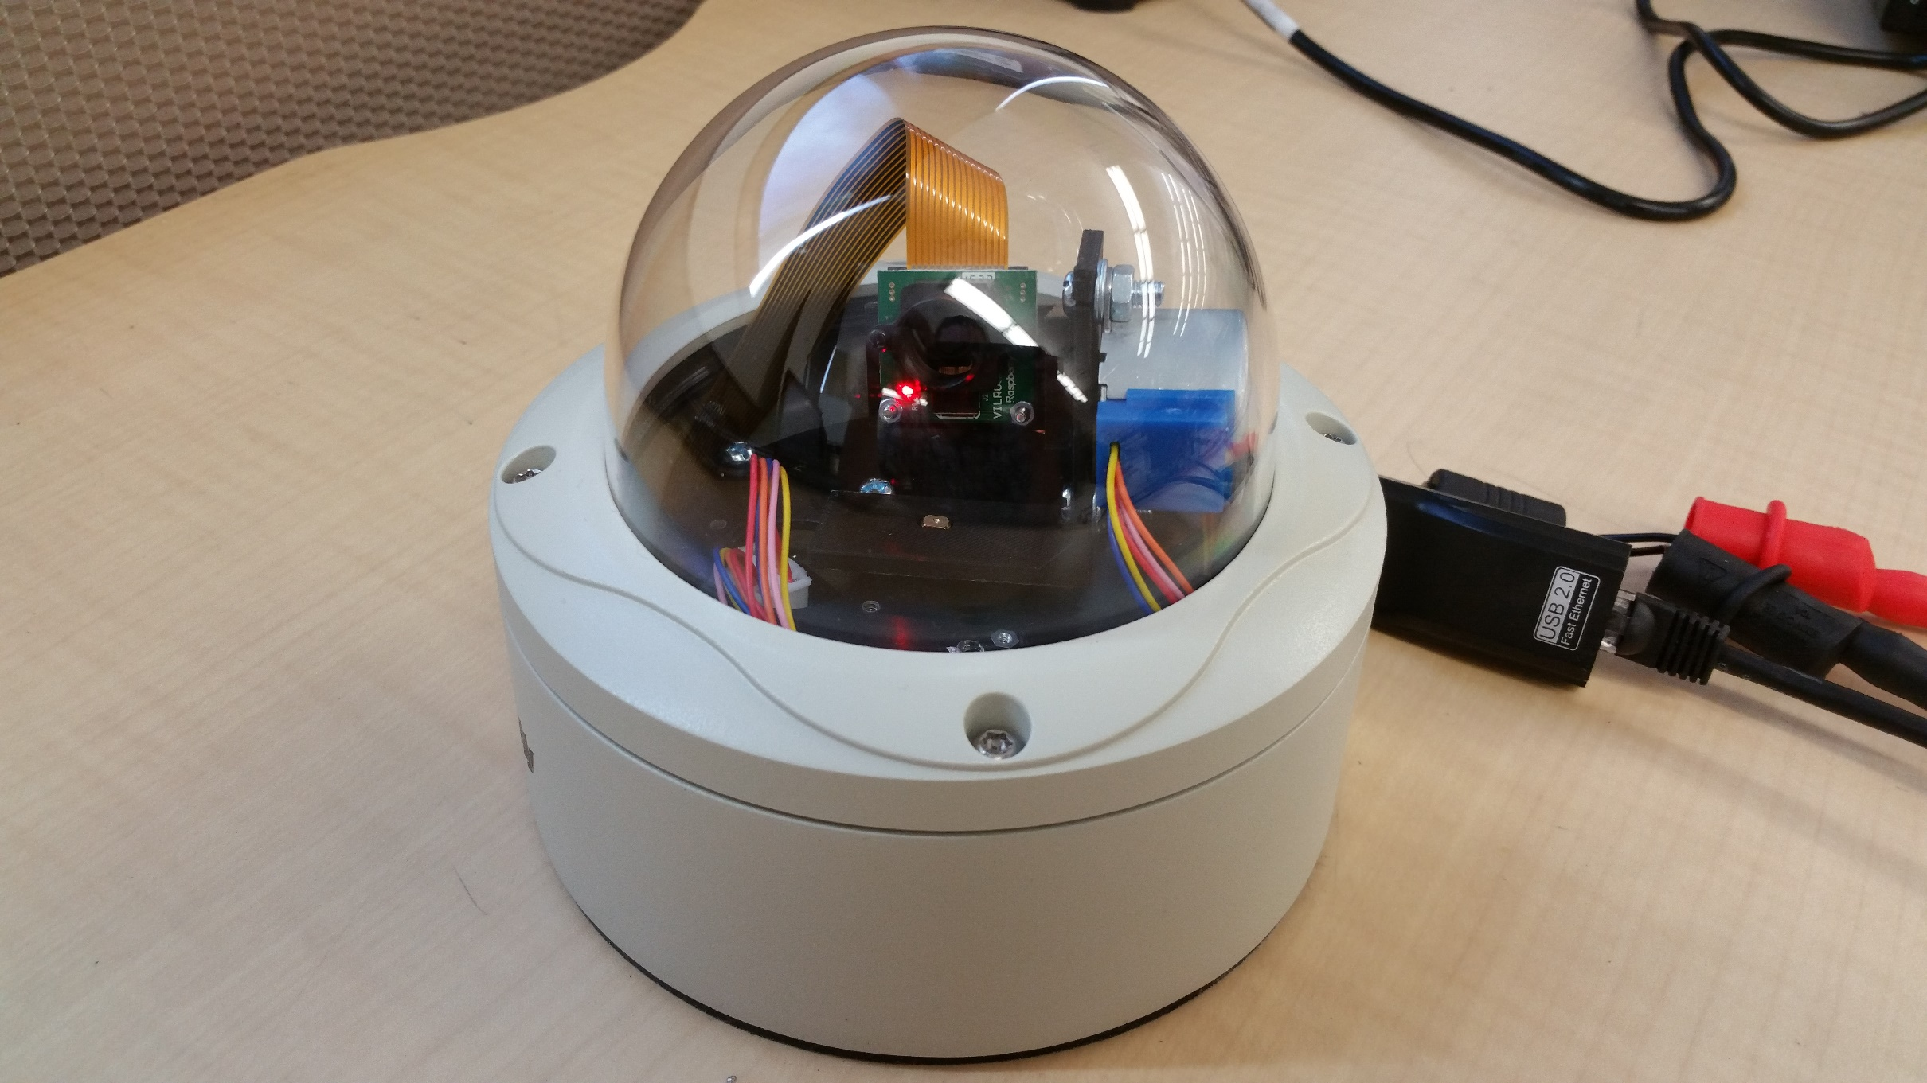
HAWKEYE: A LOW POWERED SMART CAMERA
PEYTON CASPER , RABIN DHAUBANJAR, KYLE EDELMANN, JOSE HERNANDEZ, RUCHITHA THALAKOLA
SPONSER: TRAFFICNET, LLC
INSTRUCTOR: DR. CHRISTOPHER MCMURROUGH
VISION
SYSTEM ARCHITECTURE
HARDWARE
TrafficNet, LLC is a young Limited Liability Company which has made headway in the traffic monitoring industry with the BAT-433 which, uses Bluetooth technology to calculate real-time traffic analytics, including travel times, speeds, origins and destinations of local commuters. As a subsidiary of TrafficNet, our group has accepted a role in the history of our parent company with an innovative solution to their latest ambition, the secure monitoring of even the most remote stretches of Texas highways through an affordable and low power camera.
Raspberry Pi Zero
Stepper Motors
Stepper Motors Drivers
Camera Module
SOFTWARE
Implemented as a web interface
Frontend Framework: Twitter Bootstrap
Stream: UV4L
Languages: Python, HTML, CSS, and JavaScript
MISSION
TrafficNet, LLC is dedicated to making the flow of traffic safer, smarter, and simpler to manage. Our team is engaged in the development of the next generation of traffic monitoring camera modules to be mass produced and field deployed in a broad spectrum of outdoor environments to assist traffic managers and the millions of drivers on the roads each day. Through creative innovation and meticulous design,TrafficNetPeons delivers high-quality products and top-notch service. Let us help change the way you see traffic.
ACCOMPLISHMENTS
Less than 5 watts
Less than $200
Supports the functionalities of competitors products
Ready to be commercialized
FUTURE WORK
Auto-zoom functionality
Heater feature on camera chassis
Multi-stream support on web interface
Notes:
Mission, vision, success criteria, key accomplishment points, future work,

